Slide 1
Scope of today’s work
The 2nd Law and spontaneity of phase transformations
Analytical approach to finding $∆S_{vap}$, $∆S_{fus}$, etc.

Slide 2
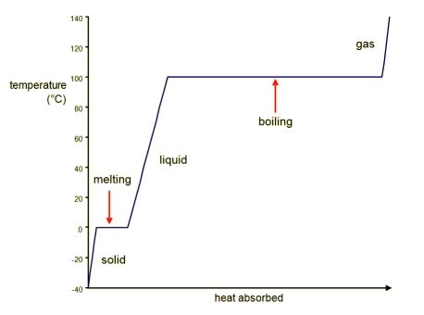
Physical context for what we’re talking about today
gas
gas
solid
solid
liquid
liquid

Slide 3
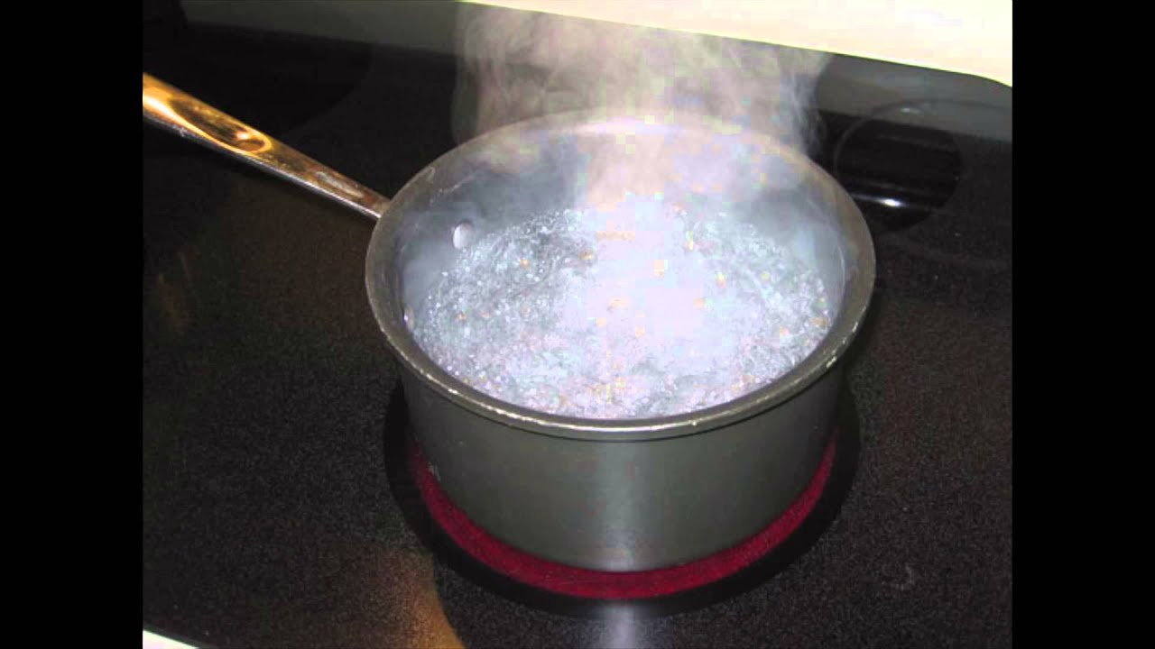

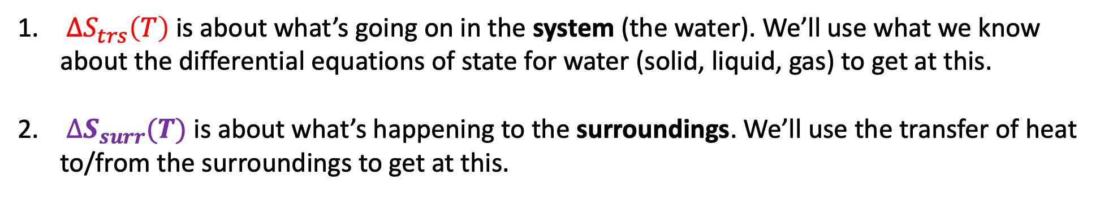
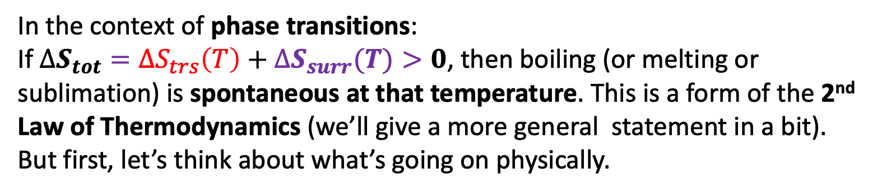
2nd Law of Thermodynamics
In the context of phase transitions:
If $∆S_{tot}={∆S}_{trs}\left(T\right)+∆S_{surr}(T)>0$, then boiling (or melting or sublimation) is spontaneous at that temperature. This is a form of the 2nd Law of Thermodynamics (we’ll give a more general statement in a bit). But first, let’s think about what’s going on physically.
-$109$
${∆S}_{trs}\left(T\right)$ is about what’s going on in the system (the water). We’ll use what we know about the differential equations of state for water (solid, liquid, gas) to get at this.
$∆S_{surr}(T)$ is about what’s happening to the surroundings. We’ll use the transfer of heat to/from the surroundings to get at this.

Slide 4
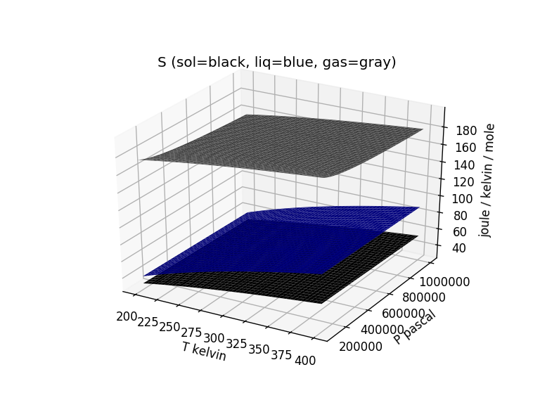


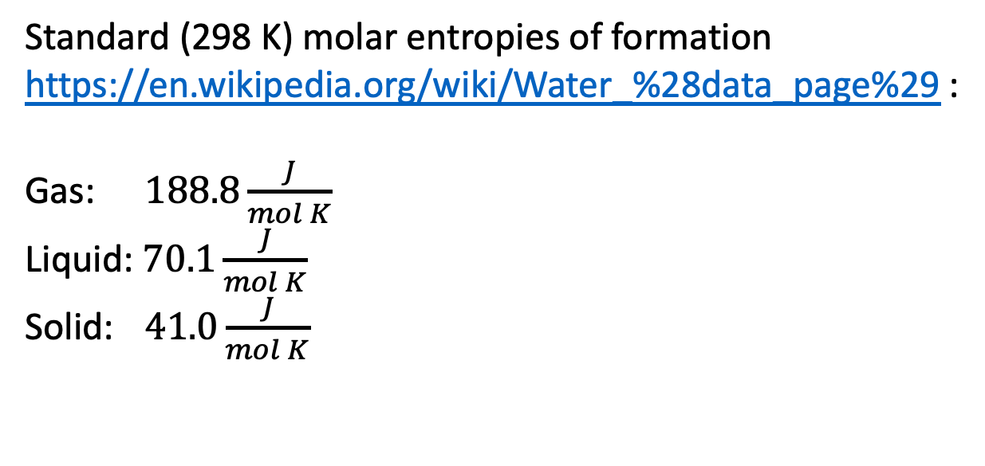

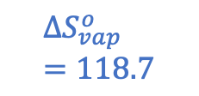

Entropy change of the system: $∆S_{vap}$ at the standard-state temperature (298 K)
Standard (298 K) molar entropies of formation https://en.wikipedia.org/wiki/Water_%28data_page%29 :
Gas: $188.8\frac{J}{mol K}$
Liquid: $70.1\frac{J}{mol K}$
Solid: $41.0\frac{J}{mol K}$
$$188.8$$
$${∆S}_{vap}^{o}=118.7$$
$$∆S_{vap}^{o}=118.7 \frac{J}{mol K}$$
$$70.1$$
$$41.0$$

Slide 5
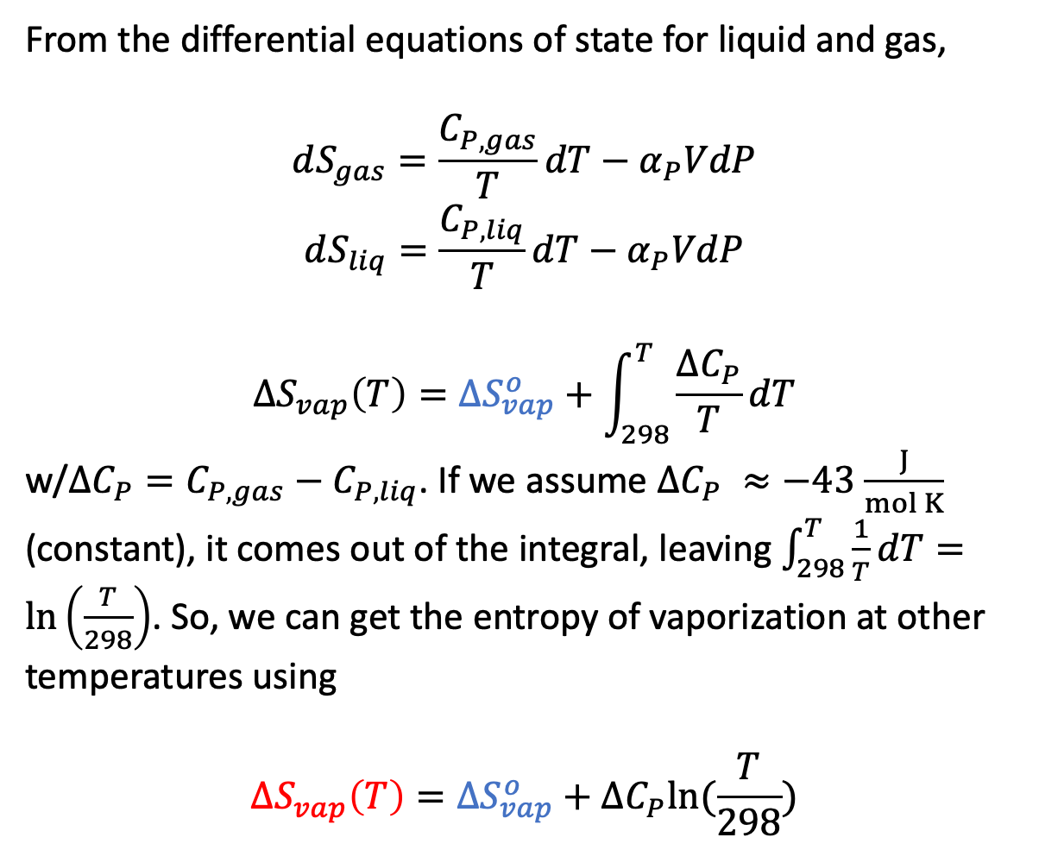

Entropy change of the system: $∆S_{vap}$ at other temperatures
From the differential equations of state for liquid and gas,
$$dS_{gas}=\frac{C_{P,gas}}{T}dT−α_{P}VdP$$
$$dS_{liq}=\frac{C_{P,liq}}{T}dT−α_{P}VdP$$
$${∆S}_{vap}\left(T\right)={∆S}_{vap}^{o}+\int_{298}^{T}{\frac{∆C_{P}}{T}dT}$$
w/$∆C_{P}=C_{P,gas}−C_{P,liq}$. If we assume $∆C_{P} ≈−43$ $\frac{J}{mol K}$ (constant), it comes out of the integral, leaving $\int_{298}^{T}{\frac{1}{T}dT}=\ln\left(\frac{T}{298}\right)$. So, we can get the entropy of vaporization at other temperatures using
$${∆S}_{vap}\left(T\right)={∆S}_{vap}^{o}+∆C_{P}ln⁡(\frac{T}{298})$$
$${∆S}_{vap}^{o}=118.7$$
$$109$$

Slide 6
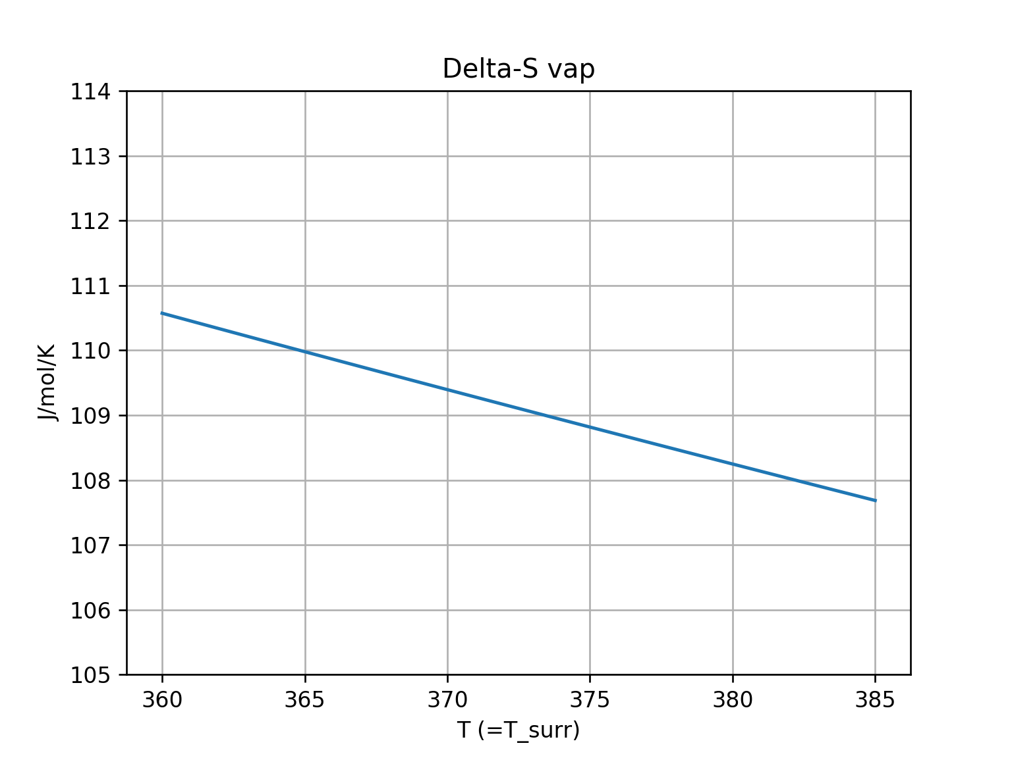
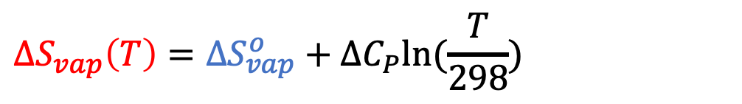
Entropy change of the system: $∆S_{vap}$ at other temperatures
$${∆S}_{vap}\left(T\right)={∆S}_{vap}^{o}+∆C_{P}ln⁡(\frac{T}{298})$$
$${∆S}_{vap}^{o}=118.7$$
$$109$$
slopes down gently
$${∆S}_{vap}\left(373 K\right)=109$$

Slide 7
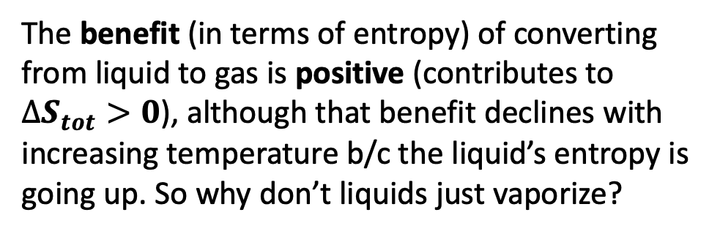
Entropy change of the system: cost-benefit analysis
$${∆S}_{vap}\left(T\right)={∆S}_{vap}^{o}+∆C_{P}ln⁡(\frac{T}{298})$$
$${∆S}_{vap}^{o}=118.7$$
$$109$$
slopes down gently
$${∆S}_{vap}\left(373 K\right)=109$$
The benefit (in terms of entropy) of converting from liquid to gas is positive (contributes to $∆S_{tot}>0$), although that benefit declines with increasing temperature b/c the liquid’s entropy is going up. So why don’t liquids just vaporize?

Slide 8
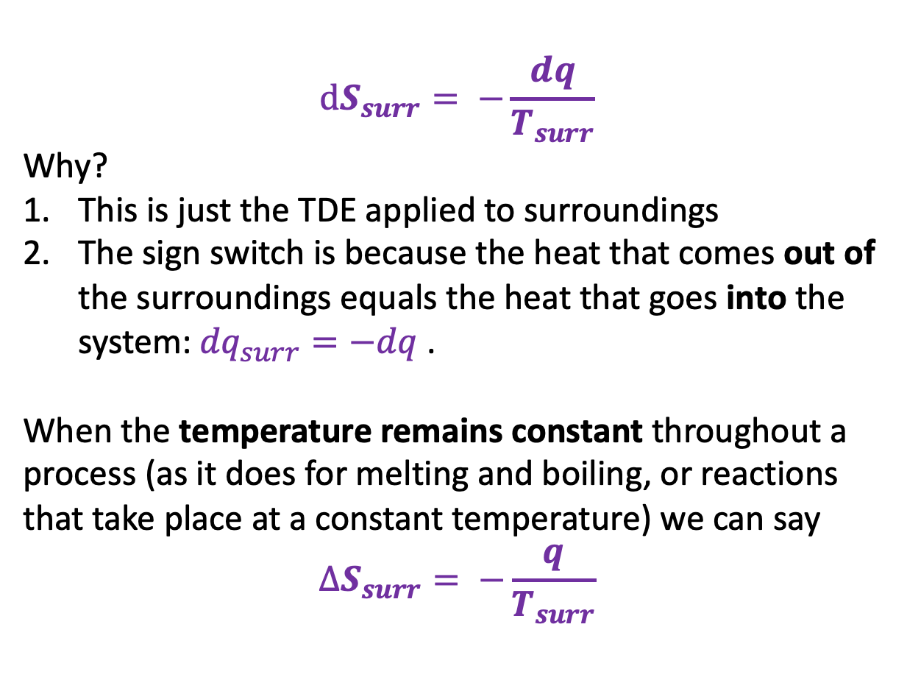
Entropy change of the surroundings: $∆S_{surr}$
$$dS_{surr}= −\frac{dq}{T_{surr}}$$
Why?
This is just the TDE applied to surroundings
The sign switch is because the heat that comes out of the surroundings equals the heat that goes into the system: ${dq}_{surr}=−dq$.
When the temperature remains constant throughout a process (as it does for melting and boiling, or reactions that take place at a constant temperature) we can say
$$∆S_{surr}= −\frac{q}{T_{surr}}$$
We can take this one step farther, knowing that $q=∆H$ for a constant-pressure process, we can say $∆S_{surr}= −\frac{∆H}{T_{surr}}$.

Slide 9
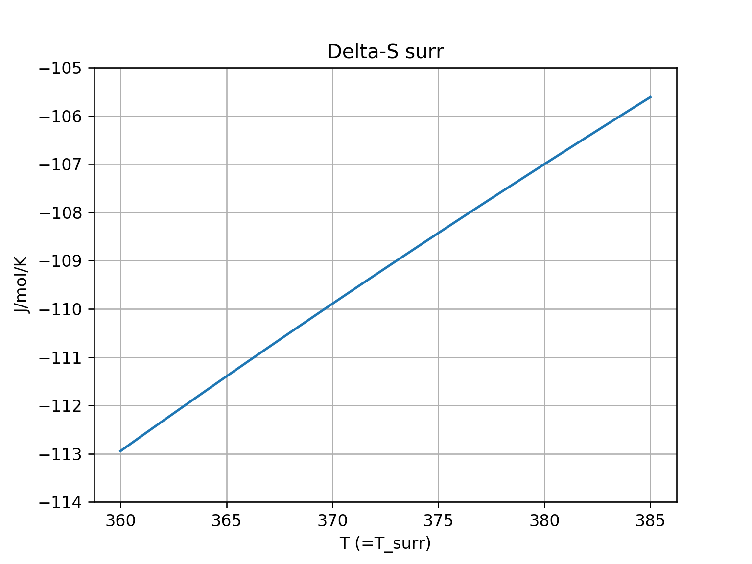



Entropy change of the surroundings: $∆S_{surr}$
$∆S_{surr}(T)= −\frac{∆H_{vap}}{T_{surr}}$
$$T_{surr}$$
-$109$

Slide 10
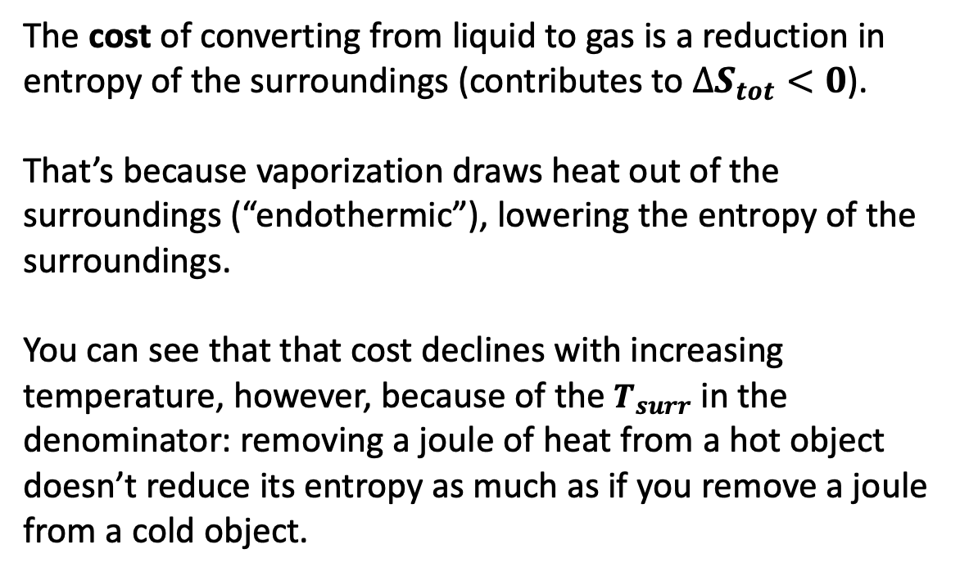
Entropy change of the surroundings: cost/benefit analysis
$∆S_{surr}(T)= −\frac{∆H_{vap}}{T_{surr}}$
The cost of converting from liquid to gas is a reduction in entropy of the surroundings (contributes to $∆S_{tot}<0$).
That’s because vaporization draws heat out of the surroundings (“endothermic”), lowering the entropy of the surroundings.
You can see that that cost declines with increasing temperature, however, because of the $T_{surr}$ in the denominator: removing a joule of heat from a hot object doesn’t reduce its entropy as much as if you remove a joule from a cold object.
$$T_{surr}$$
-$109$

Slide 11


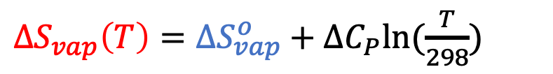
Total entropy change
$∆S_{surr}(T)= −\frac{∆H_{vap}}{T_{surr}}$
${∆S}_{vap}\left(T\right)={∆S}_{vap}^{o}+∆C_{P}ln⁡(\frac{T}{298})$
Rapidly declining cost
Slowly declining benefit
$$T_{surr}$$
$$T$$
$$109$$
-$109$

Slide 12
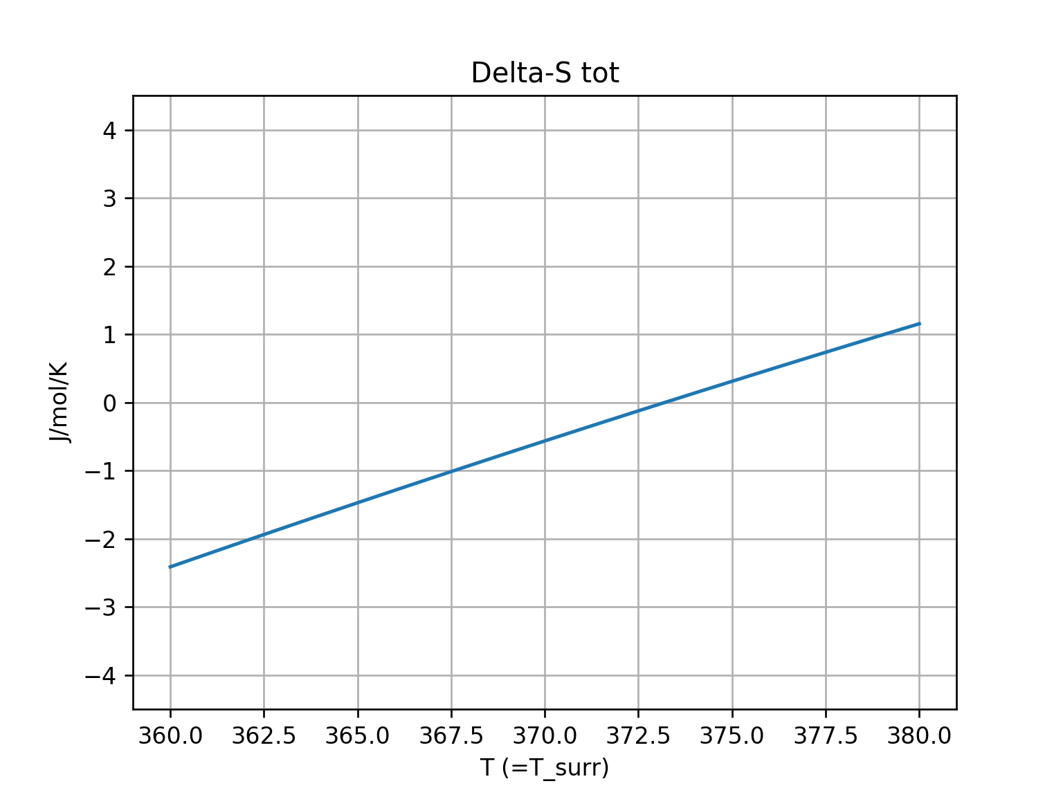

Total entropy change: $∆S_{tot}={∆S}_{vap}\left(T\right)+∆S_{surr}$
$∆S_{surr}(T)= −\frac{∆H_{vap}}{T_{surr}}$
${∆S}_{vap}\left(T\right)={∆S}_{vap}^{o}+∆C_{P}ln⁡(\frac{T}{298})$
Rapidly declining cost
Slowly declining benefit
$$∆S_{tot}={∆S}_{vap}\left(T\right)+∆S_{surr}$$
$$T_{surr}$$
$$T$$
$$109$$
-$109$
$${T=T}_{surr}$$
$${T=T}_{surr}$$

Slide 13
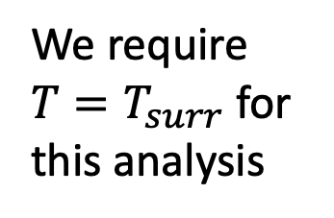
Total entropy change: $∆S_{tot}={∆S}_{vap}\left(T\right)+∆S_{surr}$
$∆S_{surr}(T)= −\frac{∆H_{vap}}{T_{surr}}$
${∆S}_{vap}\left(T\right)={∆S}_{vap}^{o}+∆C_{P}ln⁡(\frac{T}{298})$
Rapidly declining cost
Slowly declining benefit
$$∆S_{tot}={∆S}_{vap}\left(T\right)+∆S_{surr}$$
$$T_{surr}$$
$$T$$
We require $T=T_{surr}$ for this analysis
$$109$$
-$109$
$${T=T}_{surr}$$
$${T=T}_{surr}$$

Slide 14
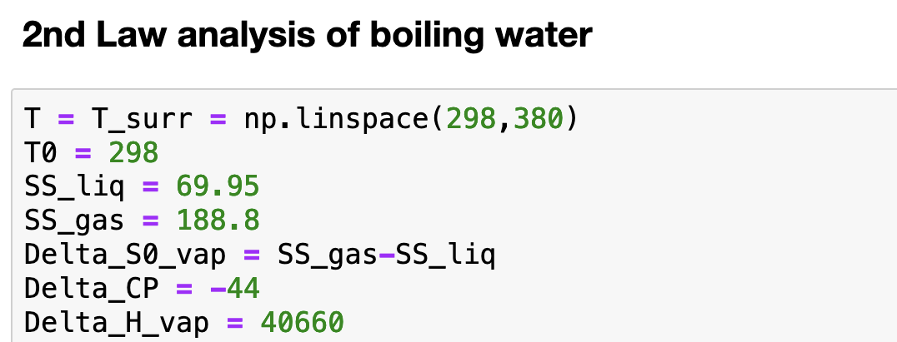
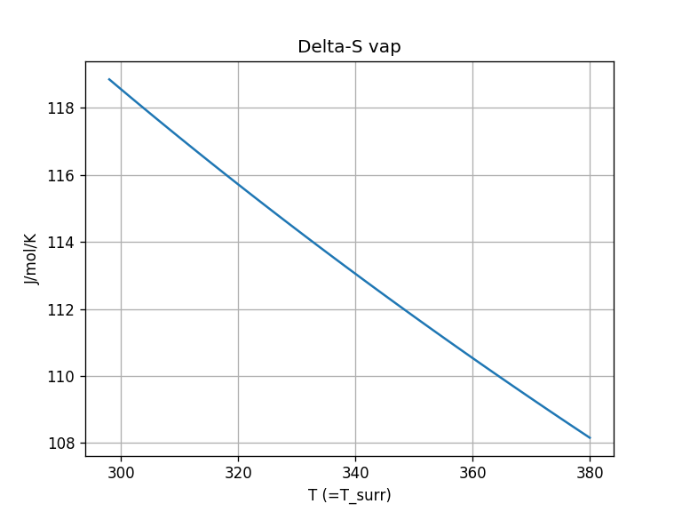
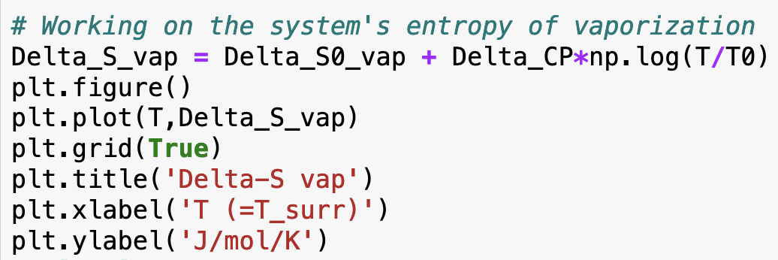
How we could do that in Python

Slide 15
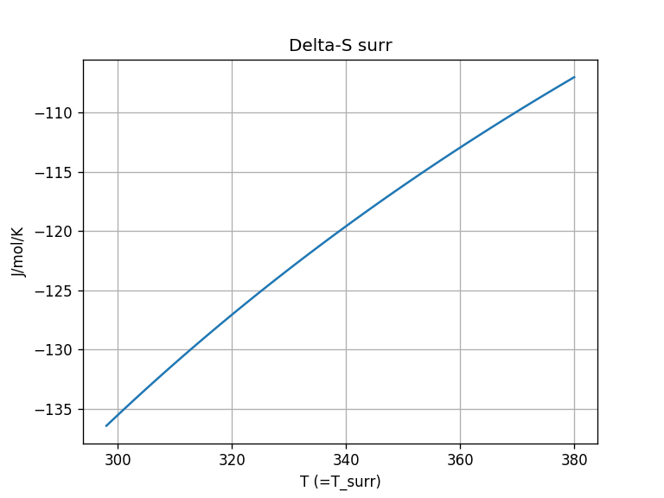
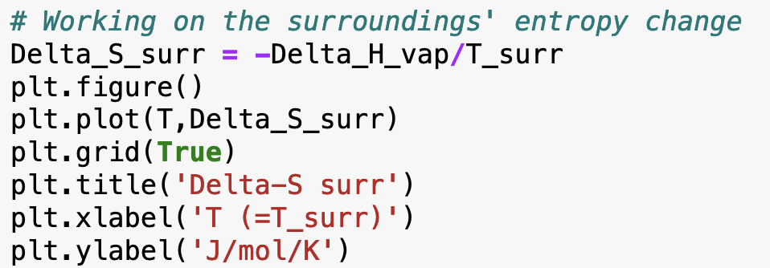
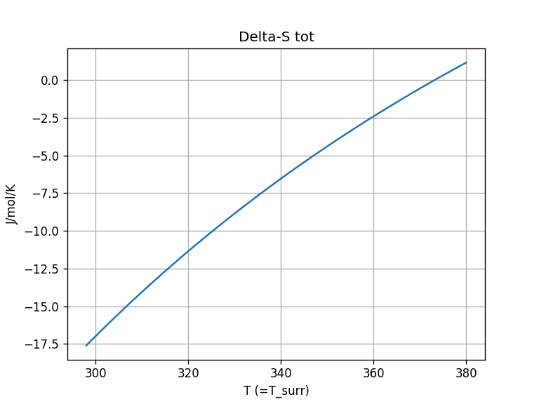
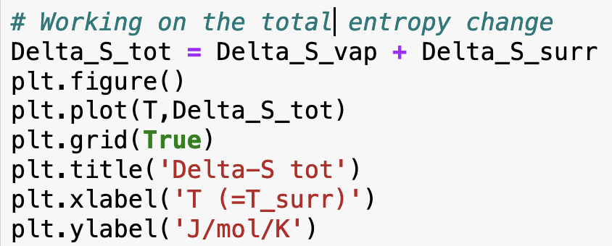
How we could do that in Python

Slide 16
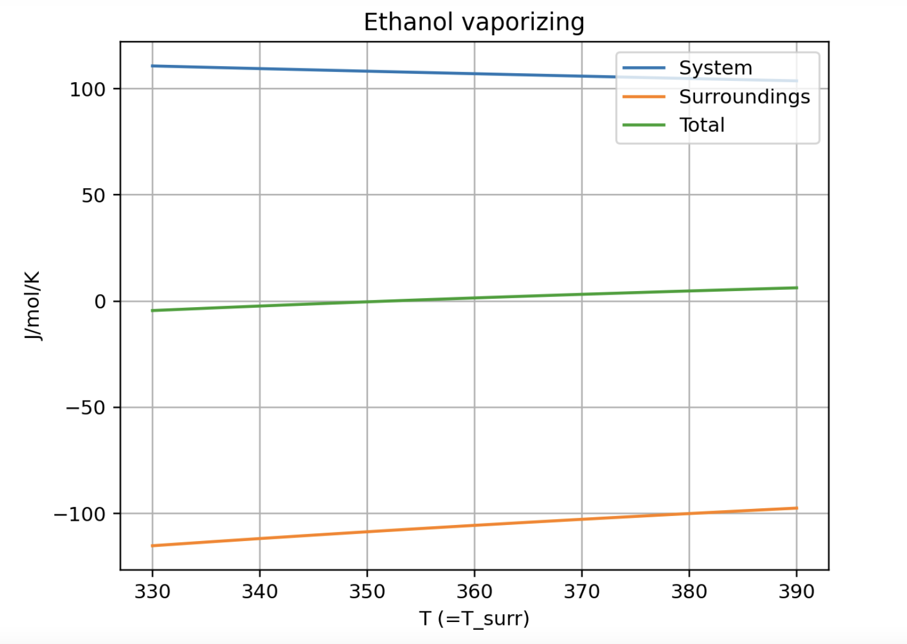
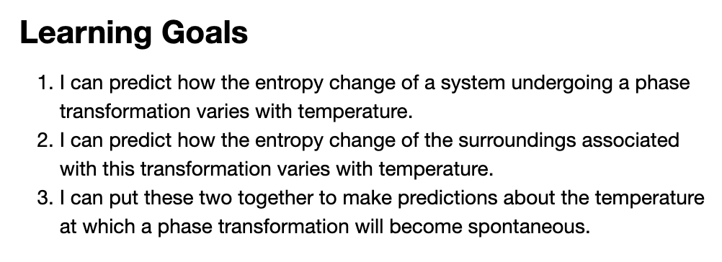
CGI: Week_11a.AnalyticalStot

Slide 17
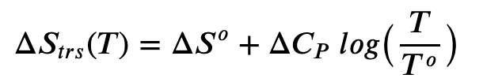

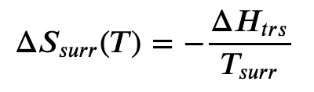
CGI: Week_11a.AnalyticalStot

